Slide 1
Merge sort, Insertion sort

Slide 2
Sorting
Selection sort or bubble sort
  Find the minimum value in the list
  Swap it with the value in the first position
  Repeat the steps above for remainder of the list (starting at the second position)
Insertion sort
Merge sort
Quicksort
Shellsort
Heapsort
Topological sort
…

Slide 3
Bubble sort and analysis
for (i=0; i<n-1; i++) {
for (j=0; j<n-1-i; j++) {
if (a[j+1] < a[j]) { // compare the two neighbors
tmp = a[j]; // swap a[j] and a[j+1]
a[j] = a[j+1];
a[j+1] = tmp;
}
}
}
Worst-case analysis: N+N-1+ …+1= N(N+1)/2, so O(N^2)

Slide 4
Insertion:
  Incremental algorithm principle
Mergesort:
  Divide and conquer principle

Slide 5
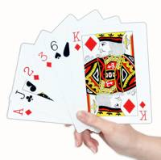
Insertion sort
1) Initially p = 1
2) Let the first p elements be sorted.
3) Insert the (p+1)th element properly in the list (go inversely from right to left) so that now p+1 elements are sorted.
4) increment p and go to step (3)

Slide 6
Go inversely!
Insert the (p+1)th element properly in the list:
go inversely from right to left) so that now p+1 elements are sorted.

Slide 7
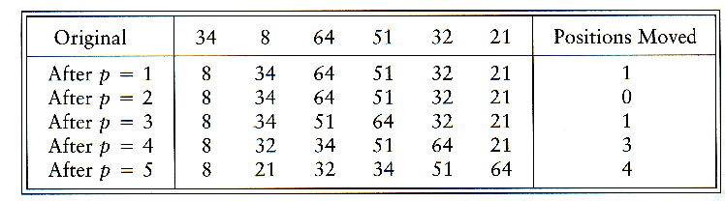
Insertion Sort

Slide 8
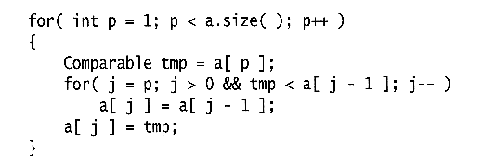
Insertion Sort
see applet
http://www.cis.upenn.edu/~matuszek/cse121-2003/Applets/Chap03/Insertion/InsertSort.html
Consists of N - 1 passes
For pass p = 1 through N - 1, ensures that the elements in positions 0 through p are in sorted order
  elements in positions 0 through p - 1 are already sorted
  move the element in position p left until its correct place is found among the first p + 1 elements

Slide 9
Extended Example
To sort the following numbers in increasing order:
34 8 64 51 32 21
p = 1; tmp = 8;
34 > tmp, so second element a[1] is set to 34: {8, 34}…
We have reached the front of the list. Thus, 1st position a[0] = tmp=8
After 1st pass: 8 34 64 51 32 21
(first 2 elements are sorted)

Slide 10
P = 2; tmp = 64;
34 < 64, so stop at 3rd position and set 3rd position = 64
After 2nd pass: 8 34 64 51 32 21
(first 3 elements are sorted)
P = 3; tmp = 51;
51 < 64, so we have 8 34 64 64 32 21,
34 < 51, so stop at 2nd position, set 3rd position = tmp,
After 3rd pass: 8 34 51 64 32 21
(first 4 elements are sorted)
P = 4; tmp = 32,
32 < 64, so 8 34 51 64 64 21,
32 < 51, so 8 34 51 51 64 21,
next 32 < 34, so 8 34 34, 51 64 21,
next 32 > 8, so stop at 1st position and set 2nd position = 32,
After 4th pass: 8 32 34 51 64 21
P = 5; tmp = 21, . . .
After 5th pass: 8 21 32 34 51 64

Slide 11
Analysis: worst-case running time
Inner loop is executed p times, for each p=1..N
⇒ Overall: 1 + 2 + 3 + . . . + N = O(N²)
Space requirement is O(N)

Slide 12
The bound is tight
The bound is tight Θ(N²)
That is, there exists some input which actually uses Ω(N²) time
Consider input as a reversed sorted list
  When a[p] is inserted into the sorted a[0..p-1], we need to compare a[p] with all elements in a[0..p-1] and move each element one position to the right
  ⇒ Ω(i) steps
  the total number of steps is Ω(Σ₁^{N-1} i) = Ω(N(N-1)/2) = Ω(N²)

Slide 13
Analysis: best case
The input is already sorted in increasing order
  When inserting A[p] into the sorted A[0..p-1], only need to compare A[p] with A[p-1] and there is no data movement
  For each iteration of the outer for-loop, the inner for-loop terminates after checking the loop condition once => O(N) time
If input is nearly sorted, insertion sort runs fast

Slide 14
Summary on insertion sort
Simple to implement
Efficient on (quite) small data sets
Efficient on data sets which are already substantially sorted
More efficient in practice than most other simple O(n2) algorithms such as selection sort or bubble sort: it is linear in the best case
Stable (does not change the relative order of elements with equal keys)
In-place (only requires a constant amount O(1) of extra memory space)
It is an online algorithm, in that it can sort a list as it receives it.

Slide 15
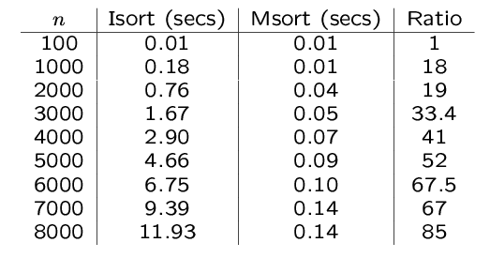
An experiment
Code from textbook (using template)
Unix time utility

Slide 16
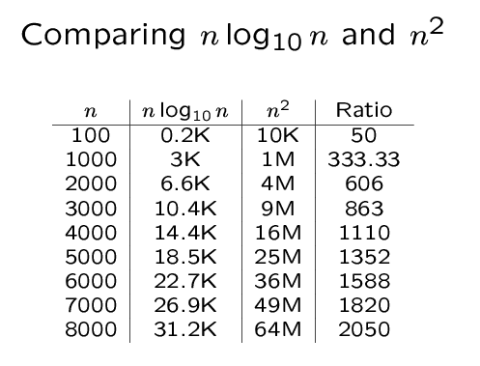

Slide 17
Mergesort
Based on divide-and-conquer strategy
Divide the list into two smaller lists of about equal sizes
Sort each smaller list recursively
Merge the two sorted lists to get one sorted list

Slide 18
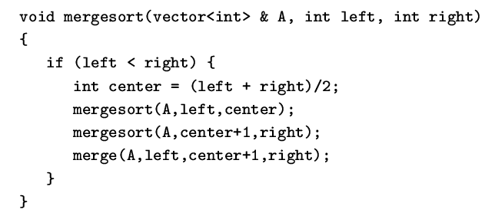
Mergesort
Divide-and-conquer strategy
  recursively mergesort the first half and the second half
  merge the two sorted halves together

Slide 19
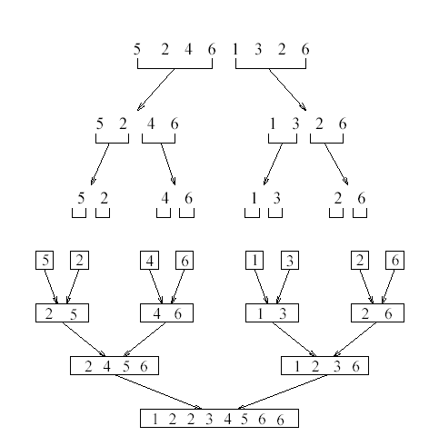
see applet
http://www.cosc.canterbury.ac.nz/people/mukundan/dsal/MSort.html

Slide 20
How do we divide the list? How much time needed?
How do we merge the two sorted lists? How much time needed?

Slide 21
How to divide?
If an array A[0..N-1]: dividing takes O(1) time
  we can represent a sublist by two integers left and right: to divide A[left..Right], we compute center=(left+right)/2 and obtain A[left..Center] and A[center+1..Right]

Slide 22
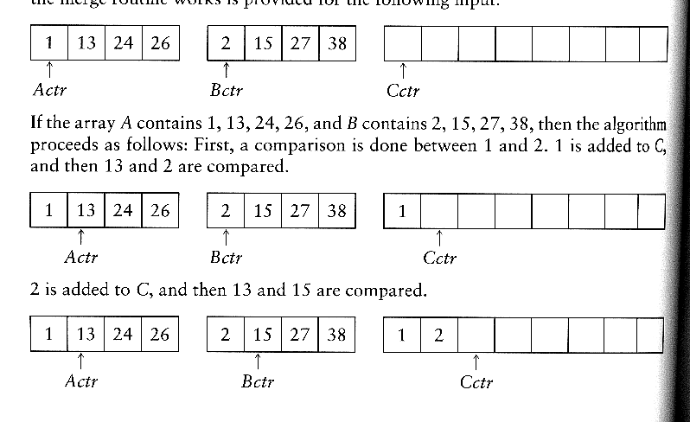
How to merge?
Input: two sorted array A and B
Output: an output sorted array C
Three counters: Actr, Bctr, and Cctr
  initially set to the beginning of their respective arrays
(1) The smaller of A[Actr] and B[Bctr] is copied to the next entry in C, and the appropriate counters are advanced
(2) When either input list is exhausted, the remainder of the other list is copied to C

Slide 23

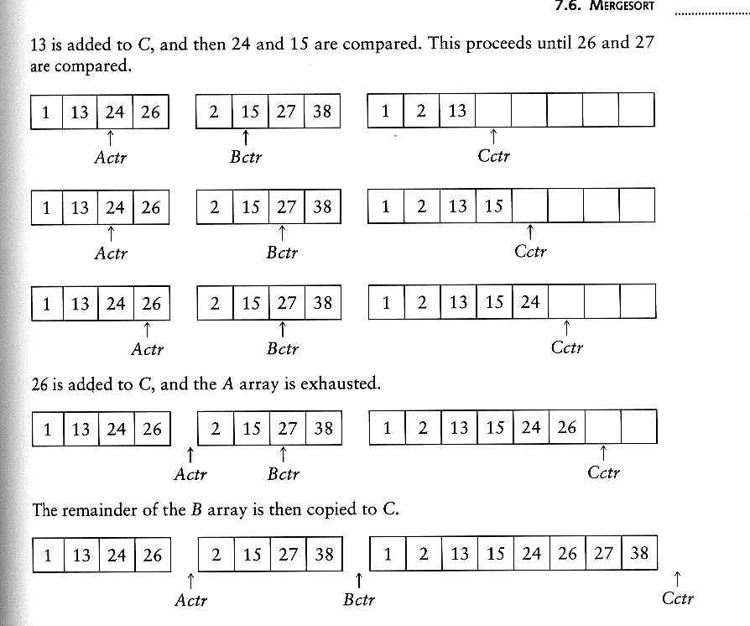
Example: Merge

Slide 24
Example: Merge...
Running time analysis:
  Clearly, merge takes O(m1 + m2) where m1 and m2 are
the sizes of the two sublists.
Space requirement:
  merging two sorted lists requires linear extra memory
  additional work to copy to the temporary array and back

Slide 25
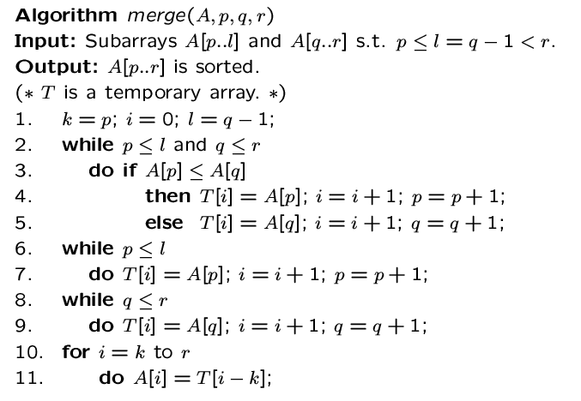

Slide 26
Analysis of mergesort
Let T(N) denote the worst-case running time of mergesort to sort N numbers.
Assume that N is a power of 2.
Divide step: O(1) time
Conquer step: 2 T(N/2) time
Combine step: O(N) time
Recurrence equation:
  T(1) = 1
  T(N) = 2T(N/2) + N

Slide 27
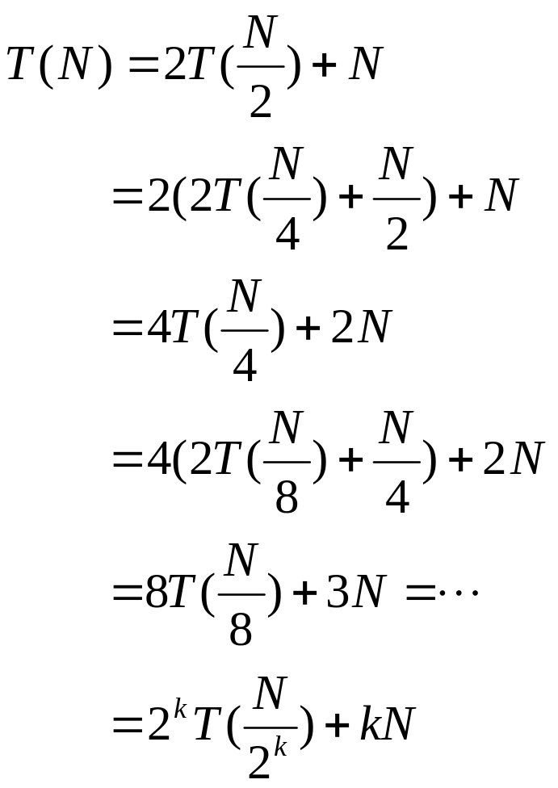
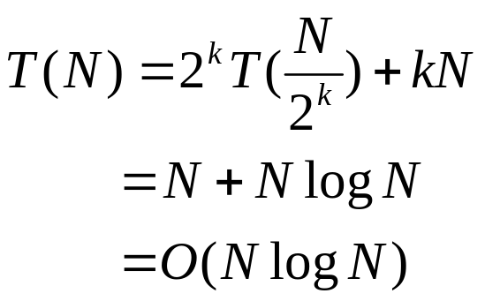
Analysis: solving recurrence
Since N=2^{k}, we have k=log₂ n

Slide 28
Don’t forget:
We need an additional array for ‘merge’! So it’s not ‘in-place’!

